Slide 1
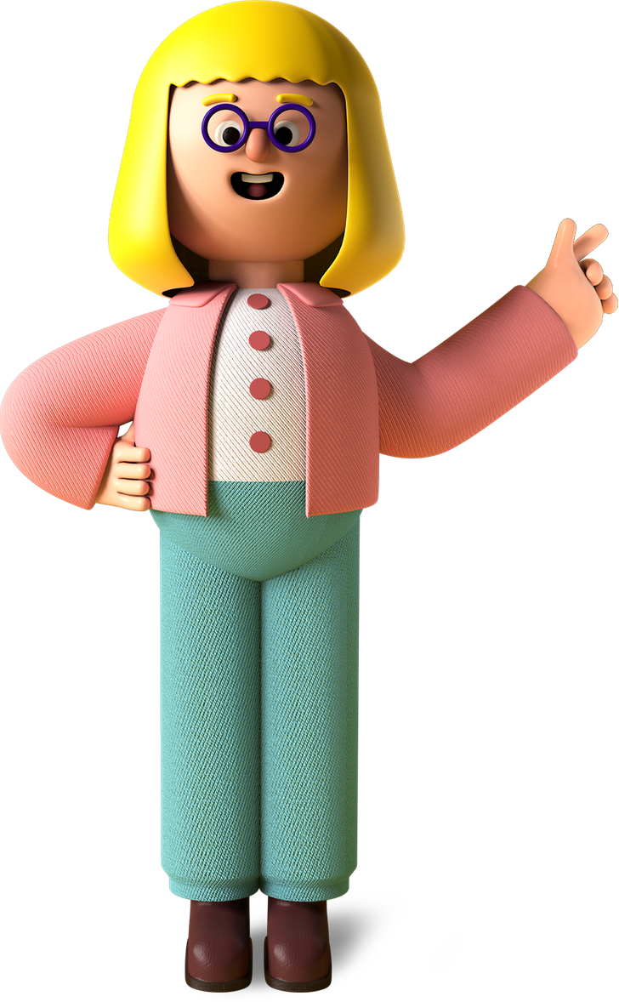


Shreetej
Project

Slide 2

Project Name
Balloon Buster : 5

Slide 3
Project Link
https://editor.p5js.org/p5estudent/sketches/5yXYlV-sI

Slide 4

My favorite part about the project

Slide 5

What I learned from it
01
02
03

Slide 6
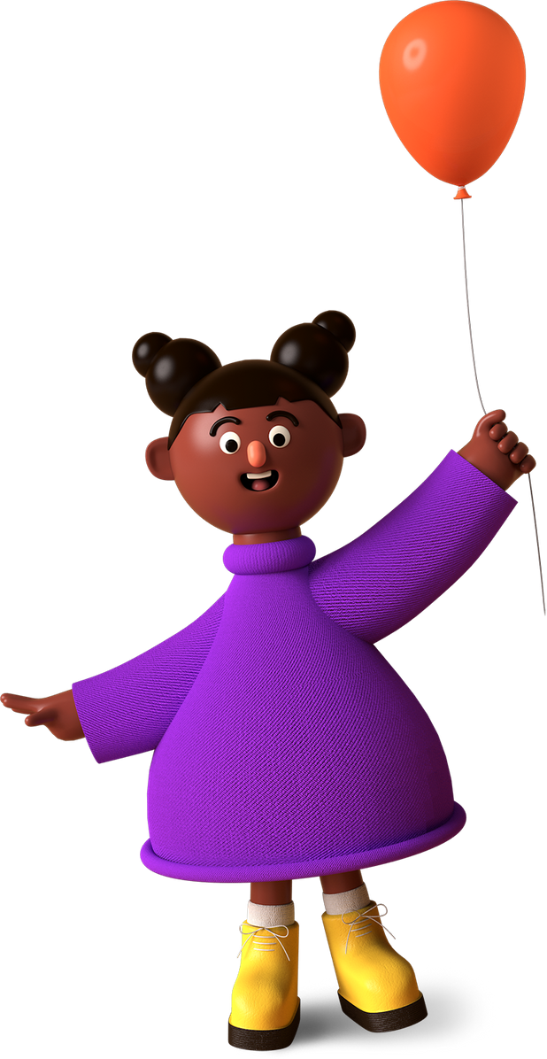
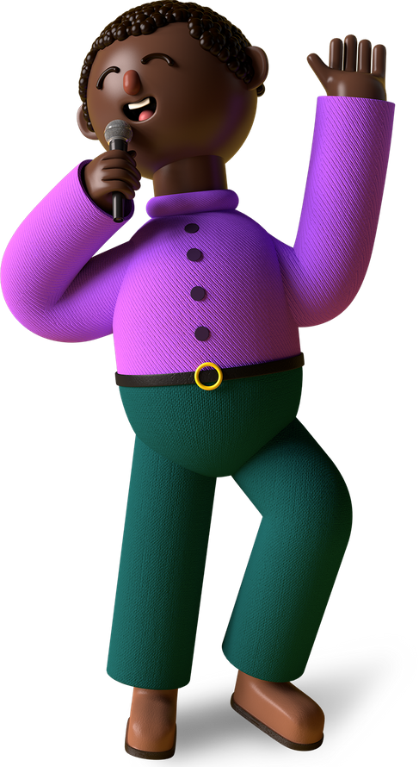
Thank You, Merry X’Mas & A Happy New Year From (Shreetej Khamitkar),
A Young Coder In The Making!

